Slide 1
ADF data flow Flatten Transformation

Slide 2
Create ADF and sample JSON file inside a storage blob container

Slide 3
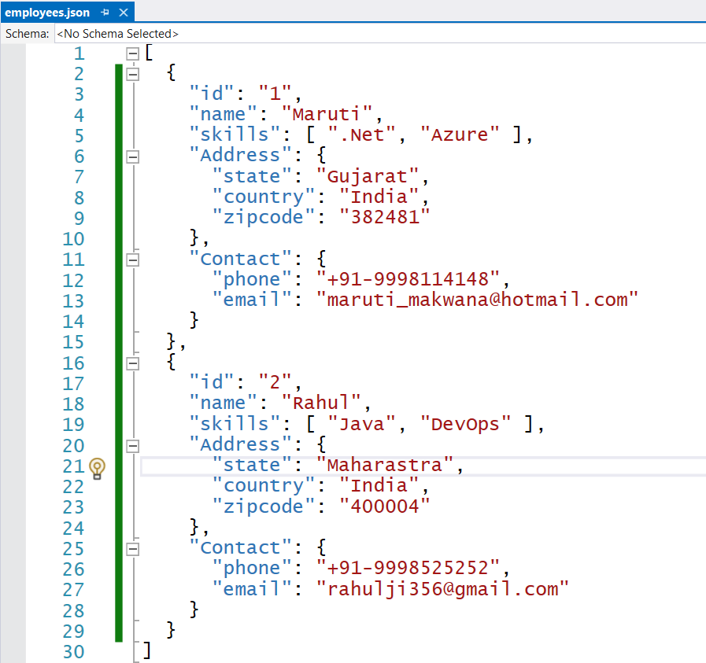

Slide 4
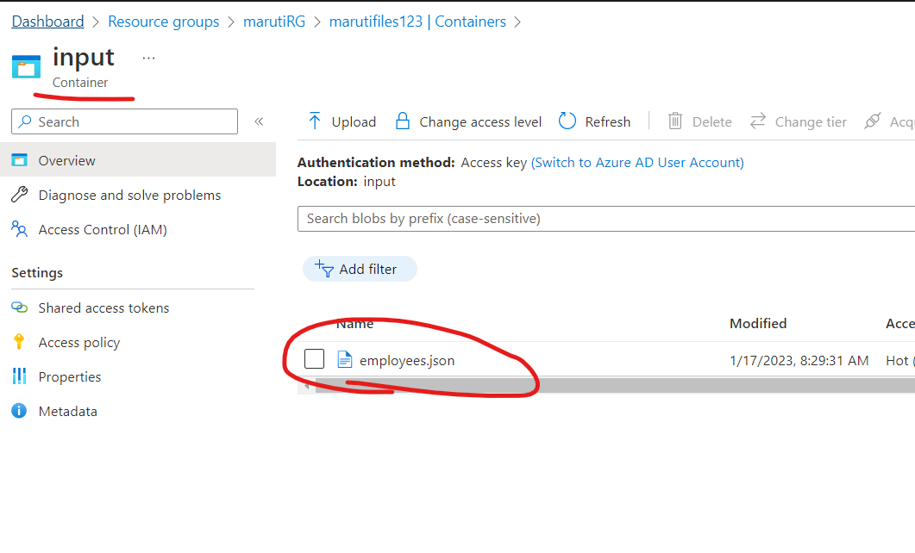

Slide 5
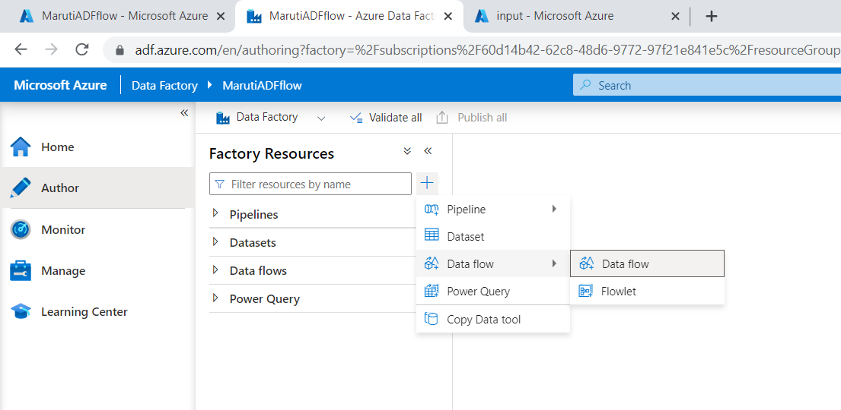

Slide 6
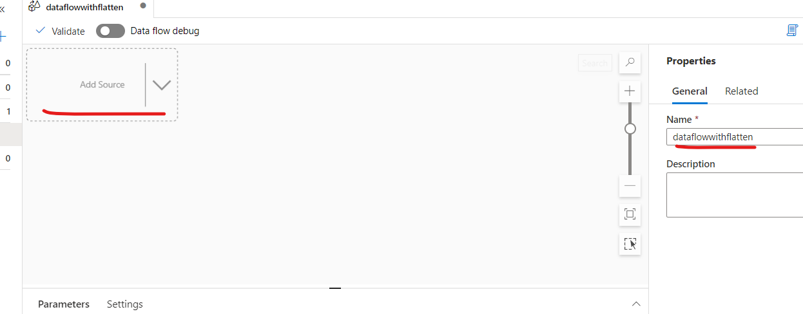

Slide 7
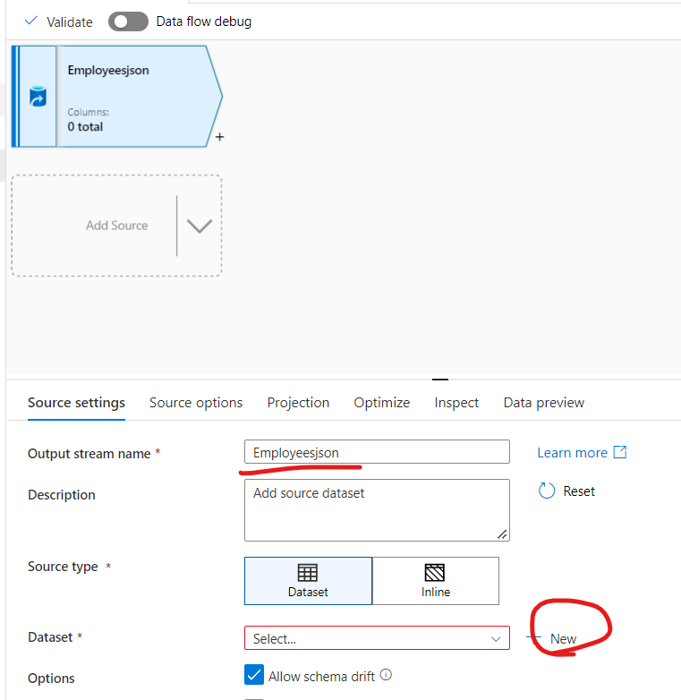

Slide 8
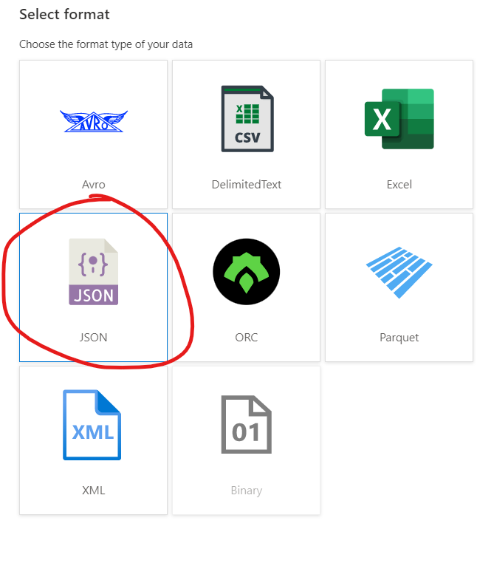

Slide 9
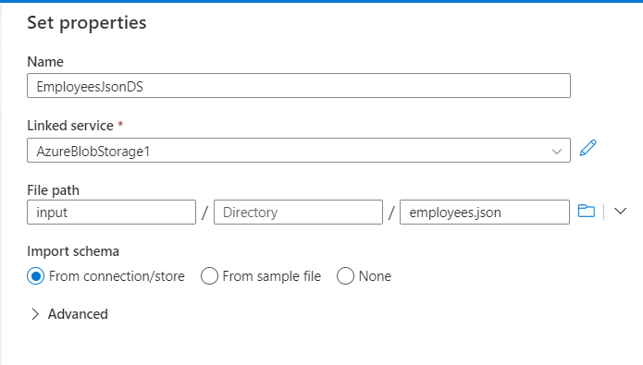

Slide 10
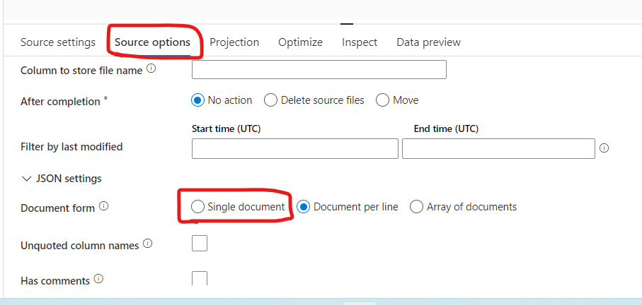
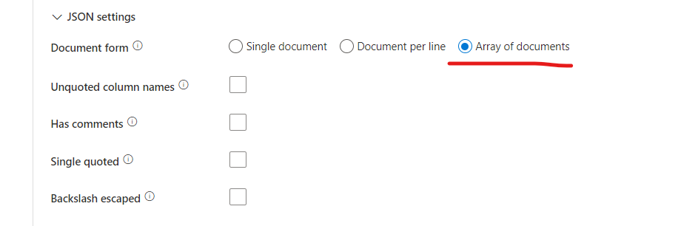

Slide 11
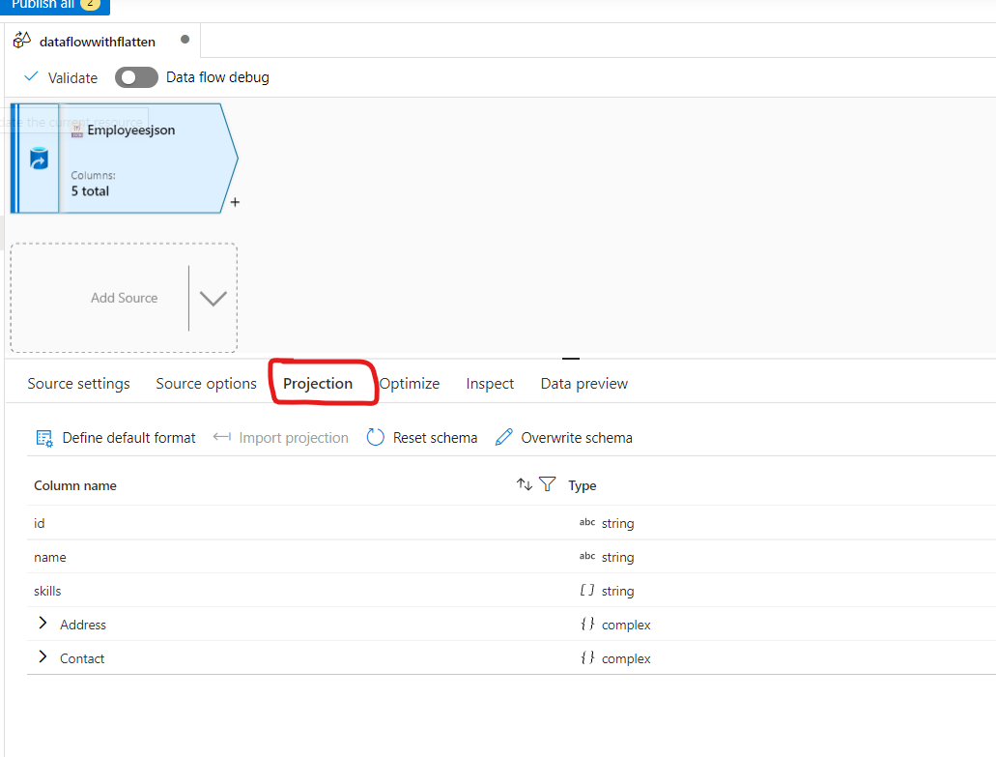

Slide 12
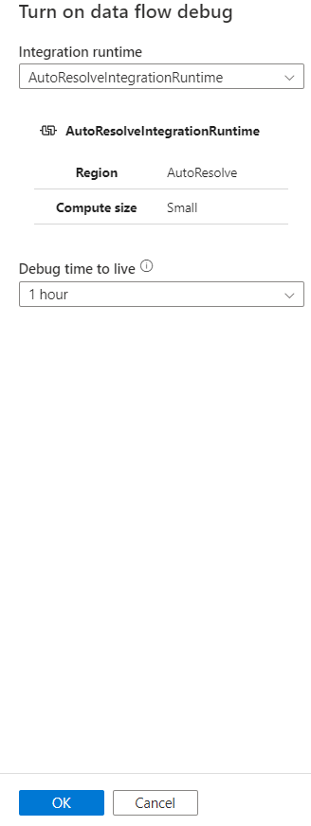
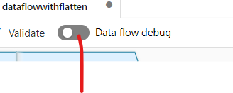

Slide 13
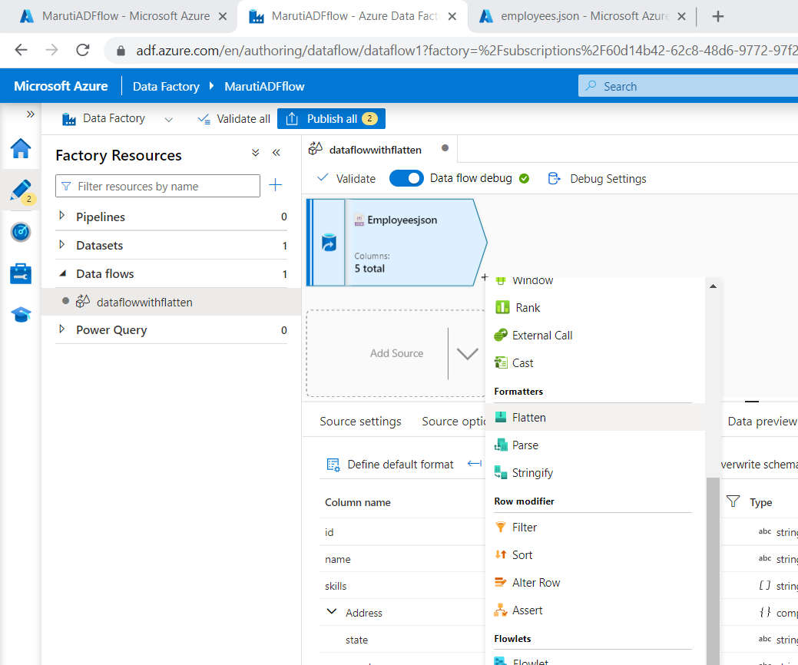

Slide 14
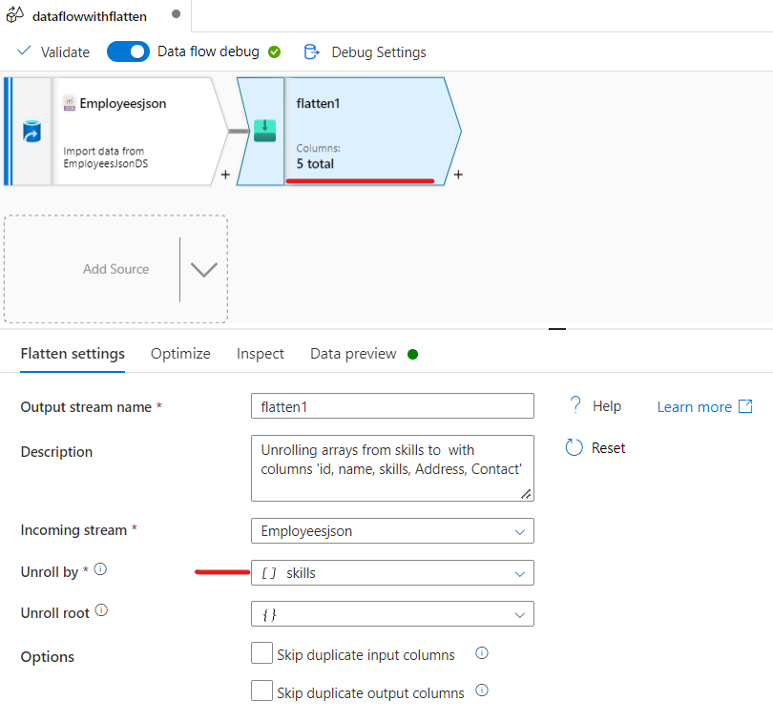

Slide 15
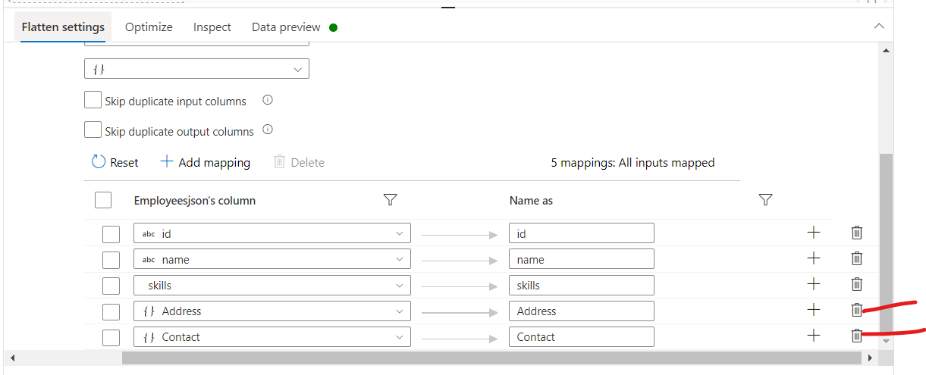

Slide 16
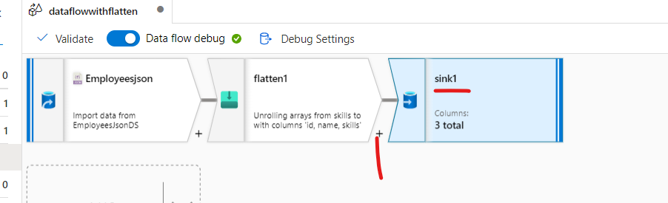

Slide 17
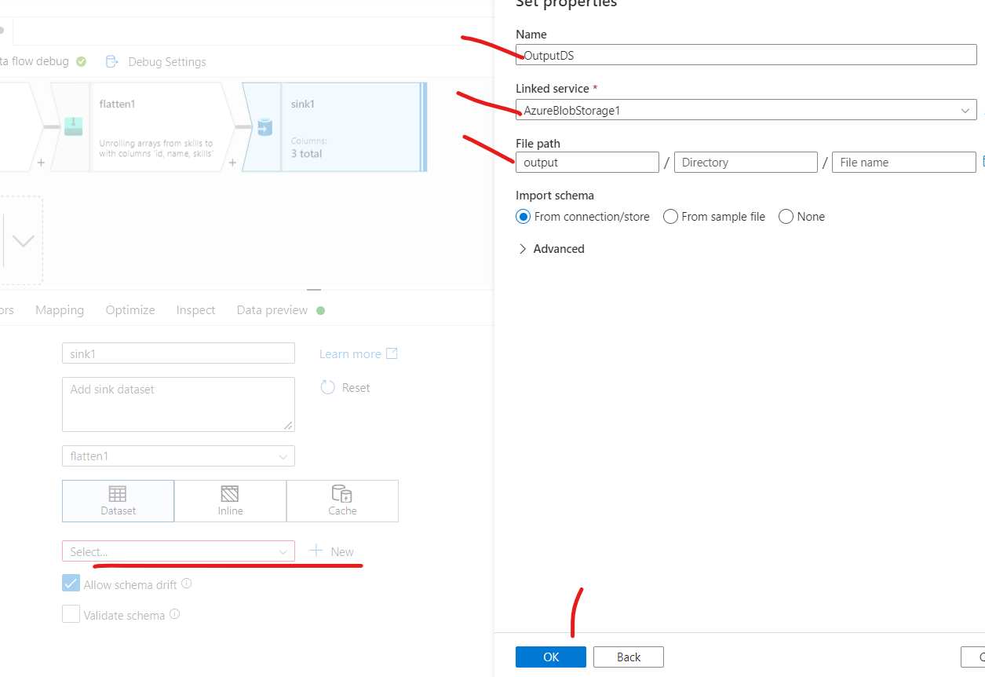

Slide 18
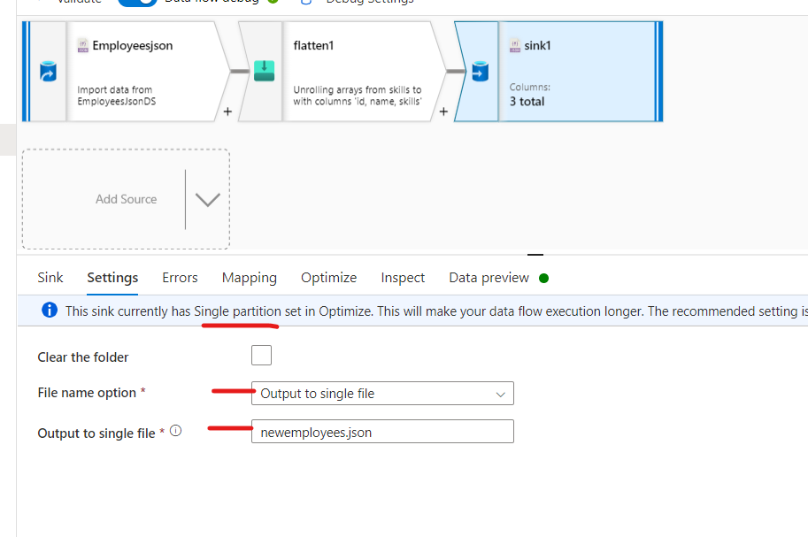

Slide 19
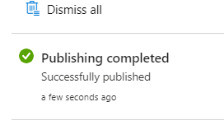

Slide 20
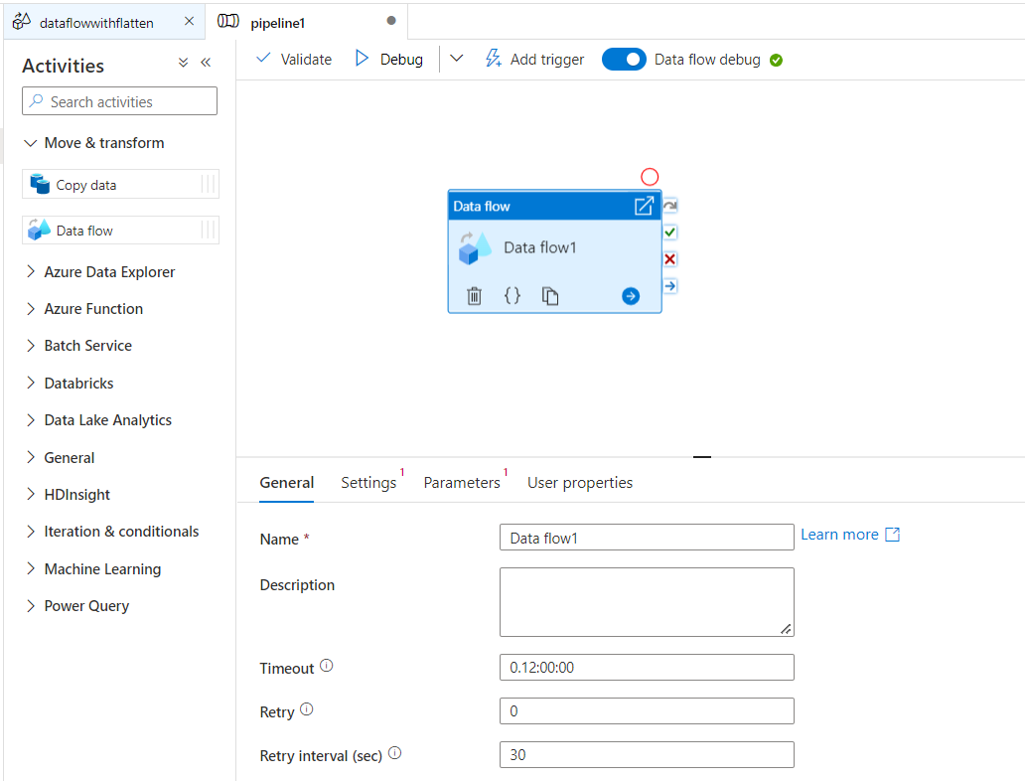

Slide 21
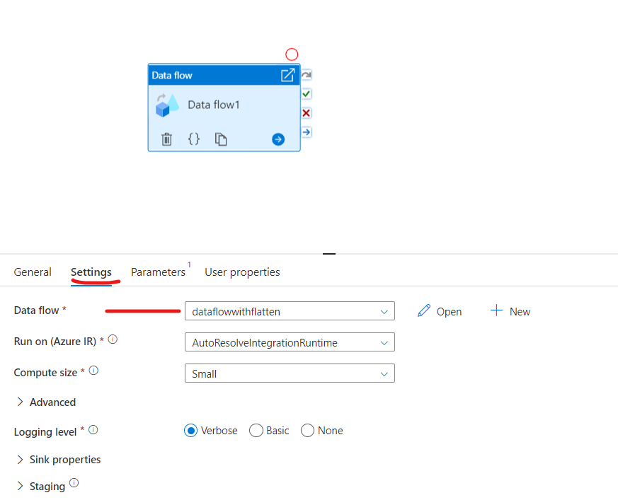

Slide 22
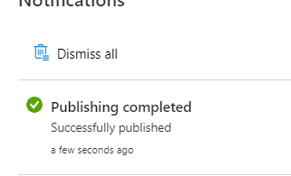

Slide 23
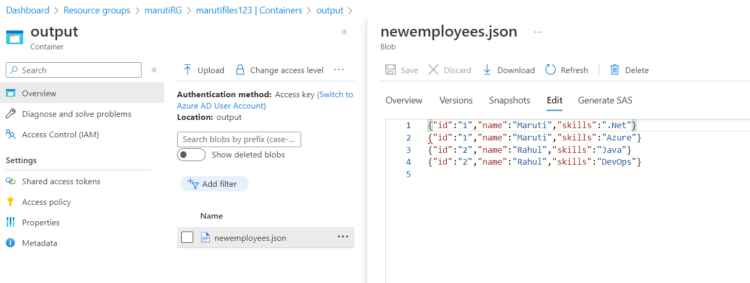

Slide 24
https://learn.microsoft.com/en-us/azure/data-factory/tutorial-data-flow

Slide 25
Introduction to Azure Synapse Analytics
Notes:
Instructor notes
This space has been left deliberately blank

Slide 26

Azure Synapse Analytics
Limitless analytics service with unmatched time to insight
Artificial Intelligence / Machine Learning / Internet of Things
Intelligent Apps / Business Intelligence
Designed for analytics workloads at any scale
Synapse Analytics
SaaS developer experiences for code free and code first
Experience
Synapse Analytics Studio
Platform
Multiple languages suited to different analytics workloads
MANAGEMENT
Languages
MANAGEMENT
SQL
Python
.NET
Java
Scala
CLI
Integrated analytics runtimes available as a dedicated and serverless offering
SQL pools offering T-SQL for batch, streaming and interactive processing
Spark pools for big data processing with Python, Scala, R and .NET
SECURITY
Form Factors
SECURITY
DEDICATED
SERVERLESS
MONITORING
Analytics Runtimes
MONITORING
SQL
METASTORE
METASTORE
DATA INTEGRATION
Integrated platform services for, management, security, monitoring, and metastore
Azure
Data Lake Storage
Common Data Model
Enterprise Security
Optimized for Analytics
Data lake integrated and Common Data Model aware
Notes:
Talking points
Azure Synapse is a limitless analytics service that brings together enterprise data warehousing and Big Data analytics. It gives you the freedom to query data on your terms, using either serverless or provisioned resources—at scale. Azure Synapse brings these two worlds together with a unified experience to ingest, prepare, manage, and serve data for immediate BI and machine learning needs.
To derive real value from your data, you require a comprehensive platform with familiar tools and a robust ecosystem of partners and ISVS to deliver the solutions you need at cloud scale
One place for all your data: This is one of the most significant pain points we hear from customers. How can I get access to all of the data internally and externally to my organization. Each system needs its own database, that is true. Microsoft’s analytics solution is able to connect to those data sources and bring that data into a cloud scale data warehouse solution for deriving insights, from a variety of data sources.
Unlimited data scale: Not only can Microsoft’s solution process these diverse types of data, it can do it at scale, without constraints typically associated with existing on premises solutions.
Familiar tools and ecosystem: And, you don’t have to hire a number of specialists to manage a niche tool. Microsoft’s offerings provide familiar tools and ecosystem to help you leverage your investment quickly.
Lower TCO: The benefits noted all accrue to a lower TCO.
There’s a range of analytical scenario’s that Azure Synapse Analytics can address
Descriptive Analytics
The world of analytics, is evolving from the typical “Descriptive Analytics”, which is all about – What is happening in my business?
Diagnostic Analytics
The data insights, provided by descriptive analytics, are needed to provide the answer to: , “Why it is happening in your business”, which is often referred to analyzing root cause, or “Diagnostic Analytics”. Both, Descriptive and Diagnostic Analytics, is seen as a workload which is primarily providing a reactive response --- from what is happening, why is it happening, to what I am I going to do about it?
Predictive Analytics
By building out predictive patterns on top of your data, by utilizing the data findings from Descriptive, Diagnostic and Predictive data, you’ll be able to identify what is based on what you get from descriptive and diagnostic analytics and used to find answers to the question of what is likely to happen in the future based on previous trends and patterns?
Prescriptive Analytics
Techniques used to provide a predictive insights into your data, is commonly introduced by building out machine learning models, to “predict” trends and give the answer to the very. When you get the findings from Descriptive, Diagnostic and Predictive analytics like what’s happened, the root cause behind that and what-might-happen in future, Prescriptive model utilizes those answers to help you determine the best course of action to choose to bypass or eliminate future issues.
Source: https://www.weirdgeek.com/2018/11/types-of-analytics/
Across all organizations and industries, common use cases are identified by the need for:
Modern data warehousing: The ability to integrate all data, including big data, with the ability to reason over data for analytics and reporting purposes, and reason over data, independent of its location or structure.
Advanced Analytics – go beyond the area of reporting, and driving analysis and turn your wealth of data into the ability to “predict what happens next”.
Real time Analytics –capture, store and analyze data in real-time or near-real time
Instructor notes and guidance
In short Azure Synapse Analytics is the one stop shop to meet all of your analytical needs in an integrated environment. The notes in the slide are for reference only should you share the slide deck. You don't need to go through them
Recommended reading for this slide
https://docs.microsoft.com/en-us/learn/modules/introduction-azure-synapse-analytics/

Slide 27
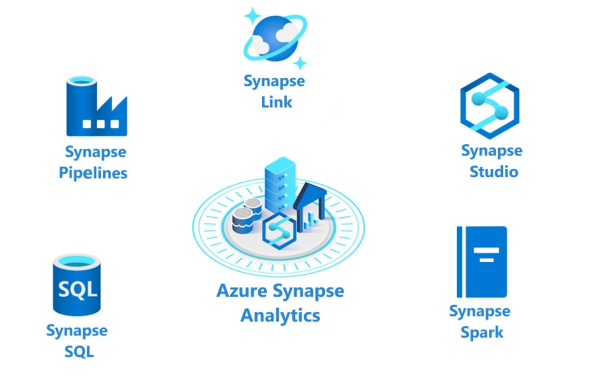
Introduction to Azure Synapse Analytics
Notes:
Talking points
The following components are available in Azure Synapse Analytics:
- Analytics capabilities are offered through Synapse SQL through either dedicated SQL pools or serverless SQL pools.
- Apache Spark pool with full support for Scala, Python, SparkSQL, and C# with Synapse Spark
- Data Integration & Orchestration to integrate your data and operationalize all of your code development with Synapse Pipelines
- Perform operational analytics with near real-time hybrid transactional and analytical processing with Azure Synapse Link.
- Use Synapse Studio to access all of these capabilities through a single Web UI
Instructor notes and guidance
Only provide the headlines of the capability on this slide, tell the students that coverage of Azure Synapse Analytics is provided in the following modules
Module 2: Run interactive queries using serverless SQL pools
Module 4: Explore, transform, and load data into the data warehouse using Azure Synapse Analytics Apache Spark
Module 5: Ingest and load Data into the Data Warehouse
Module 6: Transform Data with Azure Data Factory or Azure Synapse Pipelines
Module 7: Integrate Data from Notebooks with Azure Data Factory or Azure Synapse Pipelines
Module 8: End-to-end security with Azure Synapse Analytics
Module 9: Support Hybrid Transactional Analytical Processing (HTAP) with Azure Synapse Link
Call out to the students, that in the lab for this module, they will experience working with Apache Spark pools in Azure Synapse Analytics and how it works with a data lake, this is only one aspect of Azure Synapse analytics, and they will cover more in later modules
Recommended reading for this slide
https://docs.microsoft.com/en-us/learn/modules/survey-components-of-azure-synapse-analytics/

Slide 28
Azure Synapse SQL
Azure Synapse SQL is a distributed query system that enables you to implement data warehousing and data virtualization scenarios using standard T-SQL experiences familiar to data engineers. Synapse SQL offers both serverless and dedicated resource models to work with both descriptive and diagnostic analytical scenarios.
For predictable performance and cost, create dedicated SQL pools to reserve processing power for data stored in SQL tables.
For unplanned or ad-hoc workloads, use the always-available, serverless SQL endpoint.

Slide 29
Apache Spark pool with full support for Scala, Python, SparkSQL, and C#
You can develop big data engineering and machine learning solutions using Apache Spark for Azure Synapse.
You can take advantage of the big data computation engine to deal with complex compute transformations that would take too long in a data warehouse.
For machine learning workloads, you can use SparkML algorithms and AzureML integration for Apache Spark 2.4 with built-in support for Linux Foundation Delta Lake.

Slide 30
Azure Synapse Pipelines
Azure Synapse Pipelines leverages the capabilities of Azure Data Factory and is the cloud-based ETL and data integration service that allows you to create data-driven workflows for orchestrating data movement and transforming data at scale.
Using Azure Synapse Pipelines, you can create and schedule data-driven workflows (called pipelines) that can ingest data from disparate data stores.
You can build complex ETL processes that transform data visually with data flows or by using compute services such as Azure Databricks.

Slide 31
Azure Synapse Link
Azure Synapse Analytics enables you to reach out to operational data using Azure Synapse Link, and is achieved without impacting the performance of the transactional data store.
For this to happen, you have to enable the feature within both Azure Synapse Analytics, and within the data store to which Azure Synapse Analytics will connect, such as Azure Cosmos DB.
In the case of Azure Cosmos DB, this will create an analytical data store. As data changes in the transactional system, the changed data is fed to the analytical store in a Column store format from which Azure Synapse Link can query with no disruption to the source system.

Slide 32
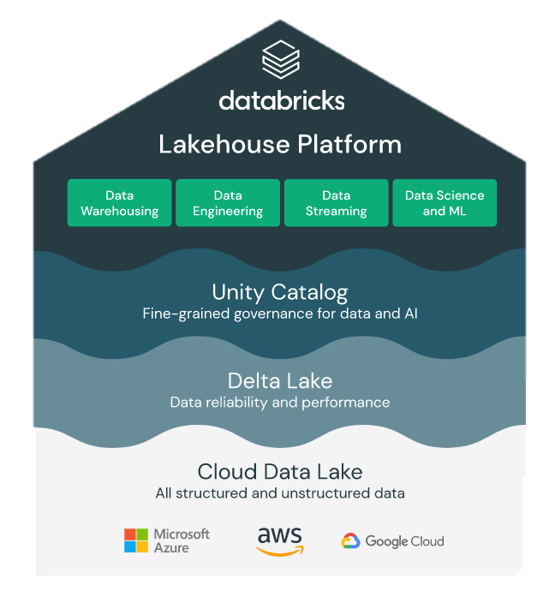
What is Databricks?
Databricks is an open and unified platform for data engineering, machine learning and analytics. It combines Data warehouse and data lakes into a LakeHouse Architecture.
https://databricks.com/product/data-lakehouse

Slide 33
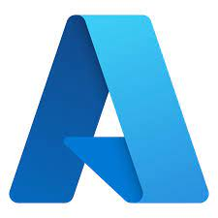

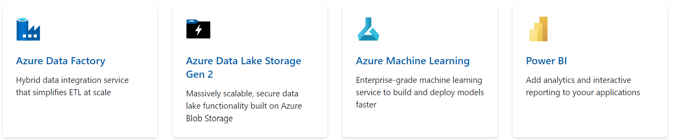
What is Azure Databricks?
Scale
High Availability
Integrations
Distributed file systems
Security
Spark
Delta lake
Python, R, SQL, Scala
Notebooks

Slide 34
What is Spark?
Apache Spark is a sophisticated distributed computation framework for executing code in parallel across many different machines.
Spark uses clusters of machines to process big data by breaking a large task into smaller ones and distributing the work among several machines
Below diagram represents how Spark uses different components to coordinate work across a cluster of computers
Driver
Executor
Executor
Executor
Task
Task
Task
Task
Task
Task

Slide 35
What is Spark?
Driver
The driver is the machine in which application runs. It is responsible for 3 main things :
Maintaining information about the spark application
Responding to user’s program
Analyzing, distributing and scheduling work across the executors
Executors
Each executor will hold the chunk of the data to be processed. This chunk is called partition. It is a collection of rows that sits on one physical machine in the cluster. The executors are responsible for carrying out the work assigned
by the driver. Each executor is responsible for 2 things
Execute the code assigned by driver
Report the state of the computation back to the driver
Task
Tasks are created by the driver and assigned a partition of data to process. A partition is a collection of rows
That sits on one physical machine in your cluster. Then tasks are assigned to slots for parallel execution.
Once started each task will fetch its assigned partition from the original data source

Slide 36
Azure Databricks Components
Workspaces
A workspace is an environment for accessing all of your Azure Databricks assets. A workspace organizes objects (notebooks, libraries, dashboards, and experiments) into folders and provides access to data objects and computational resources.
Notebook
A web-based interface to documents that contain runnable commands, visualizations, and narrative text.
Library
A package of code available to the notebook or job running on your cluster. Databricks runtimes include many libraries and you can add your own.
Databricks File System (DBFS)
A filesystem abstraction layer over a blob store. It contains directories, which can contain files (data files, libraries, and images), and other directories. DBFS is automatically populated with some datasets that you can use to learn Azure Databricks.

Slide 37
Azure Databricks Components
Cluster
A set of computation resources and configurations on which you run notebooks and jobs. There are two types of clusters: all-purpose and job.
You create an all-purpose cluster using the UI, CLI, or REST API. You can manually terminate and restart an all-purpose cluster. Multiple users can share such clusters to do collaborative interactive analysis.
The Azure Databricks job scheduler creates a job cluster when you run a job on a new job cluster and terminates the cluster when the job is complete. You cannot restart an job cluster.
Pool
A set of idle, ready-to-use instances that reduce cluster start and auto-scaling times. When attached to a pool, a cluster allocates its driver and worker nodes from the pool. If the pool does not have sufficient idle resources to accommodate the cluster’s request, the pool expands by allocating new instances from the instance provider. When an attached cluster is terminated, the instances it used are returned to the pool and can be reused by a different cluster.
Job
A non-interactive mechanism for running a notebook or library either immediately or on a scheduled basis.

Slide 38
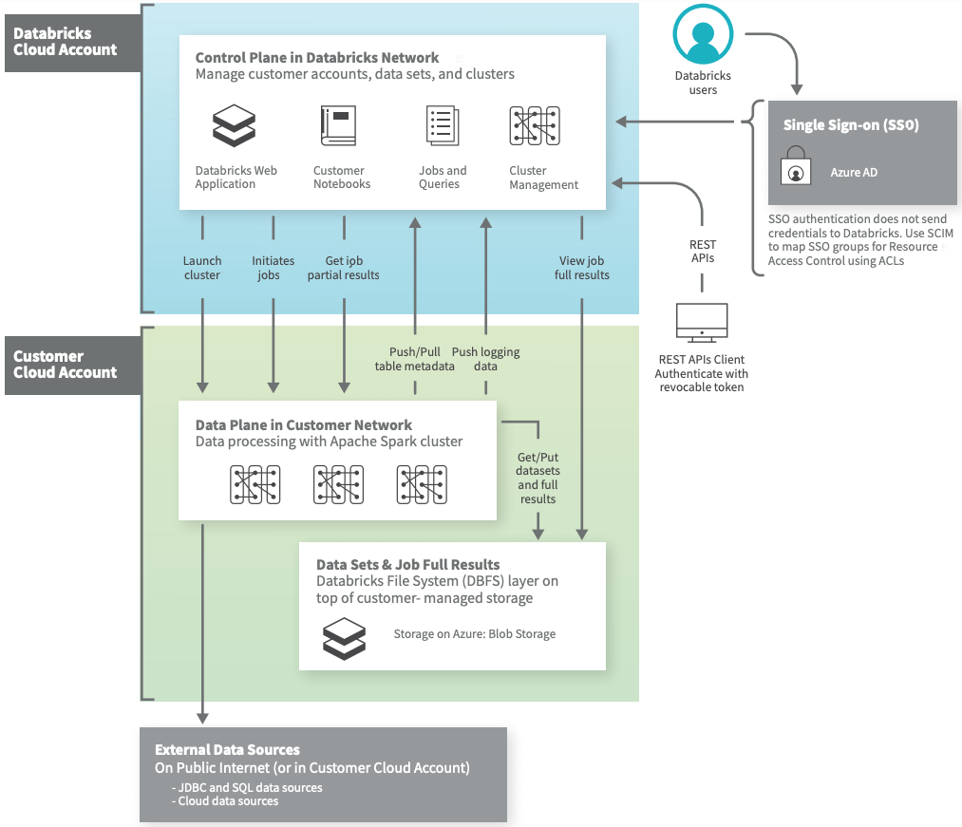
Azure Databricks Architecture
Azure Databricks operates out of a control plane and a data plane.
→The control plane includes the backend services that Azure Databricks manages in its own Azure account. Notebook commands and many other workspace configurations are stored in the control plane and encrypted at rest.
→The data plane is managed by your Azure account and is where your data resides. This is also where data is processed. You can use Azure Databricks connectors so that your clusters can connect to external data sources outside of your Azure account to ingest data or for storage. You can also ingest data from external streaming data sources, such as events data, streaming data, IoT data, and more.

